Slide 1




Kanak print-n-pack
C
Mahendra Mehta - 9322099267
kanakprints1@gmail.com

Slide 2
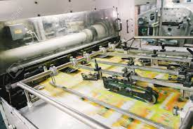
C
About us
Established in the year 1997, we “Kanak Print-N-Pack ” is one of the Leading Manufacturer and Dealer of a wide range of Paper, PVC & PP Products used in the packaging and value addition for your products
We are engaged in manufacturing, supplying, wholesaler, distributer, trading a wide assortment.
  Printed Satin
  Ribbon Roll
  Rubber Silicon Label and Taffeta Labels
  Printed Stickers, Paper Sticker.
  Packaging like Clear PVC Bag, Soft PVC Pouches
  Stitched Pvc bags
  Thermocol sheets
  Packaging Boxes
  Rubber tags & Rubber keychain
Our valued clients can avail these products from us at reasonable rates. Ably led by “Mr. Mahendra Mehta” to outshine all competitors in all aspects.We have gained a remarkable and strong position in the market.

Slide 3
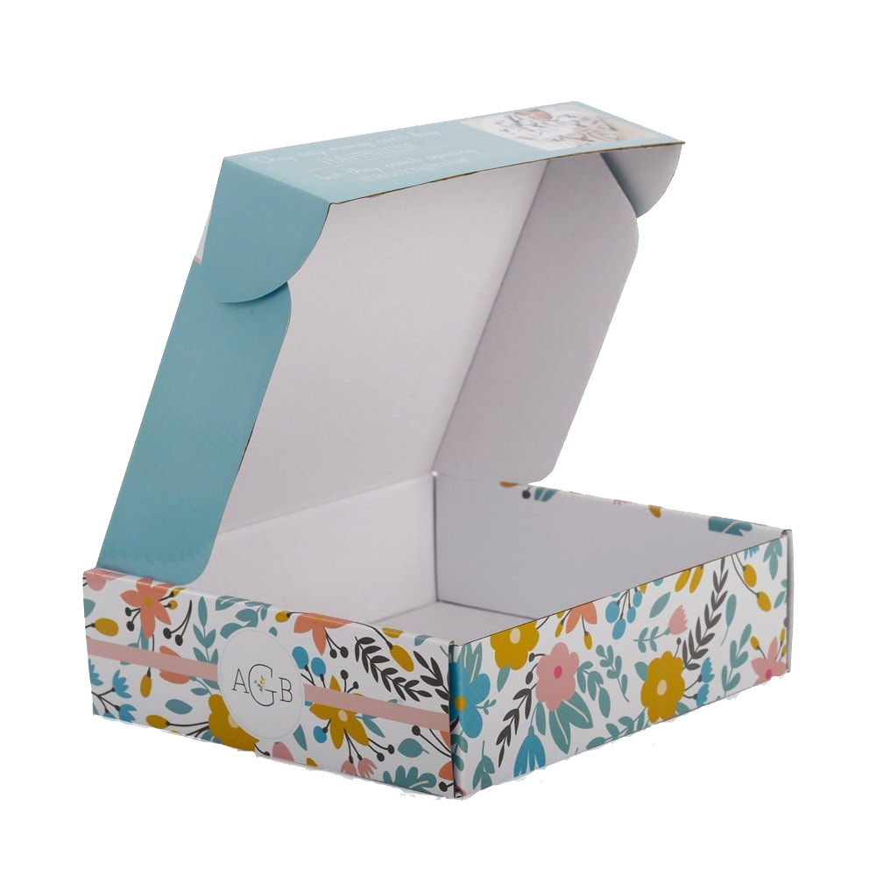

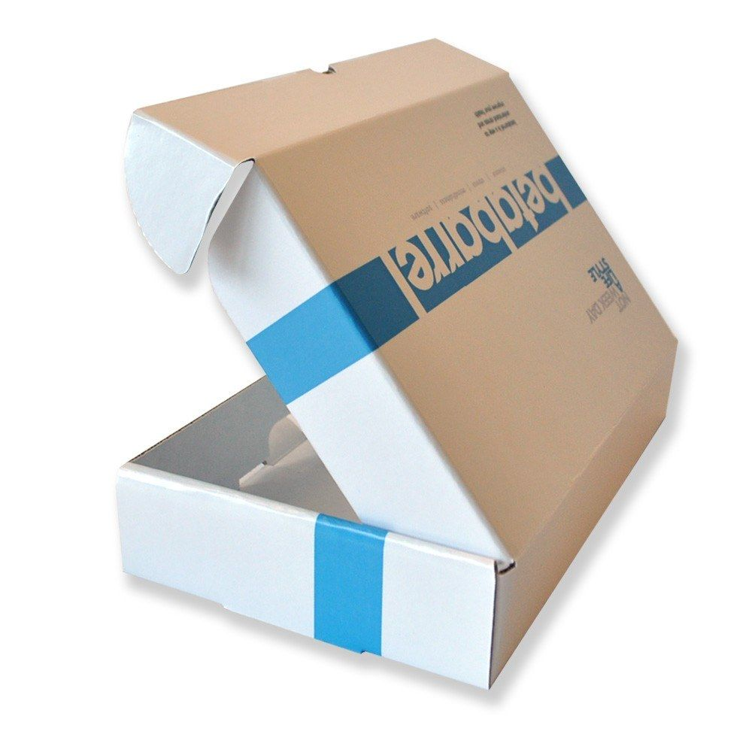
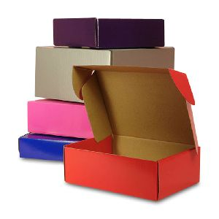
C
PACKAGING BOXES
Usage/Applications | Features
Material | Cardboard, Corrugations
Usage | Product Packaging, Promotion
Color | Multi Color
Printing | Offset & Screen
Pattern | Printed, Plain

Slide 4

C
Contact Us
Office : 9/11,Ladwadi,Shakti Sadan,3rd Floor, R N 20,Old Hanuman Lane,Kalbadevi Road, Nr Old Hanuman Lane, Mumbai-400002.
Rishabh Mehta : 8097489291
Works: Unit No 106, 1st Floor, building no A6, Prerna Complex,Dapoda Road, Val Village, Bhiwandi 421302, Thane.
kanakprints1@gmail.com

